Slide 1

Credit Card Prediction Using Machine Learning
Submitted by- Gaurav Rawat

Slide 2

Introduction
In this presentation, we will explore how machine learning can be used to predict credit card risk. Machine learning is a type of artificial intelligence that allows computers to learn from data without being explicitly programmed. In the case of credit card prediction, machine learning models can be trained on historical data of credit card applications to identify patterns that can be used to predict whether a new applicant is likely to repay a loan. This information can be valuable to banks and other financial institutions, as it can help them to make better decisions about which applicants to approve for credit cards.

Slide 3

Data Collection
This data may include:
Transaction details (amount, type, date, time, location)
Cardholder information (name, address, phone number)
Merchant information (name, location)
Past fraud history (if available)

Slide 4

Data Preprocessing
Cleaning
Data cleaning
Identify and handle missing values (e.g., fill with mean/median, remove rows)
Correct inconsistencies (e.g., standardize formats)
Remove outliers (e.g., transactions with extremely high amounts)
Engineering
Feature engineering
Create new features from existing data (e.g., difference between past and current balance)
Encode categorical variables (e.g., one-hot encoding for transaction types)

Slide 5
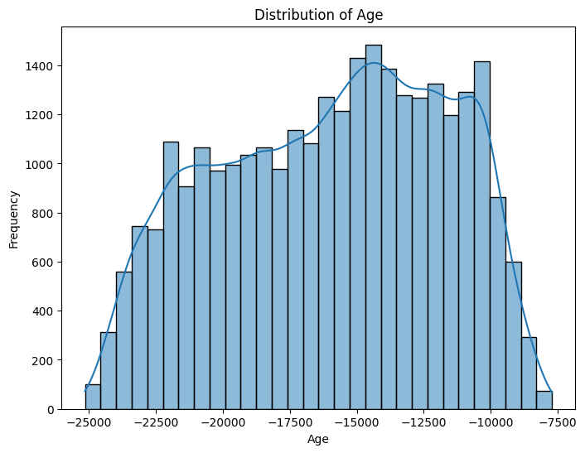
Data Visualization
Histogram of the 'Age' column

Slide 6
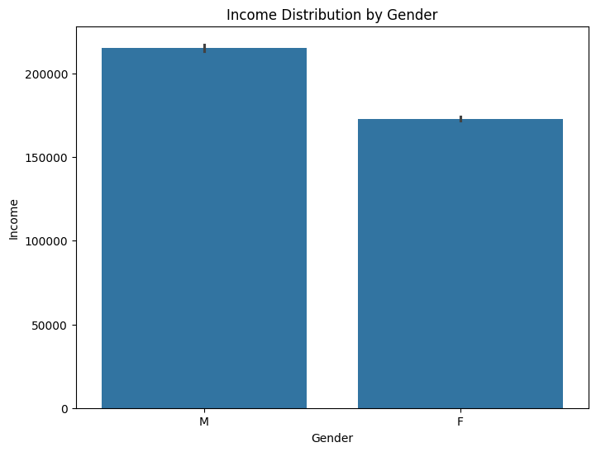
Bar plot of 'Income' by 'Gender'

Slide 7
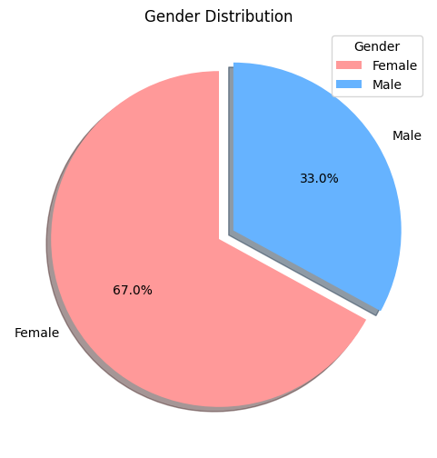
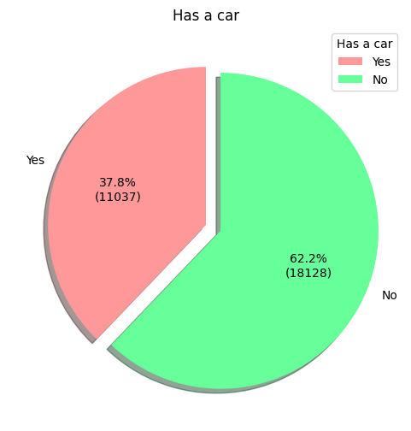
Gender Distribution Has A Car

Slide 8
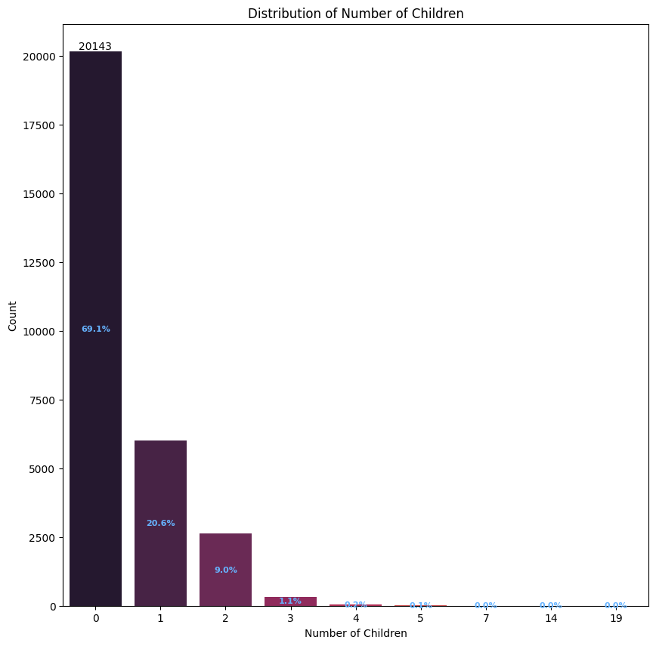

Slide 9
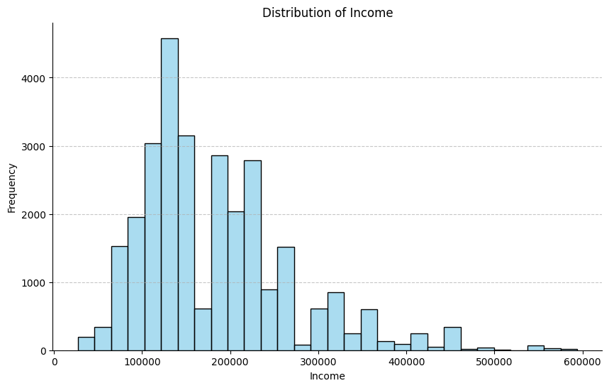

Slide 10
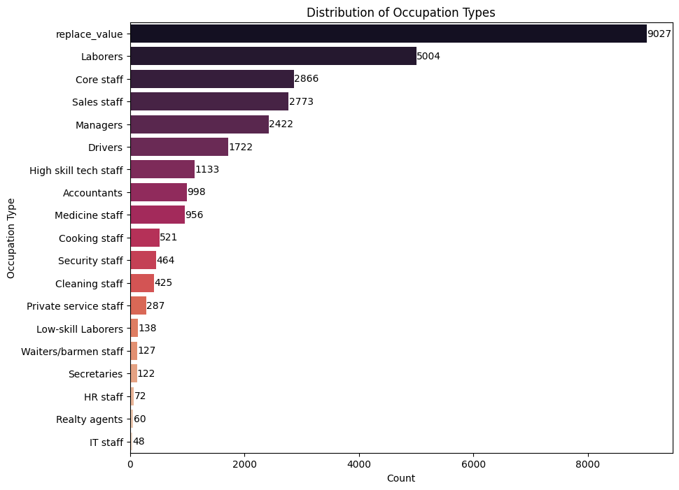

Slide 11
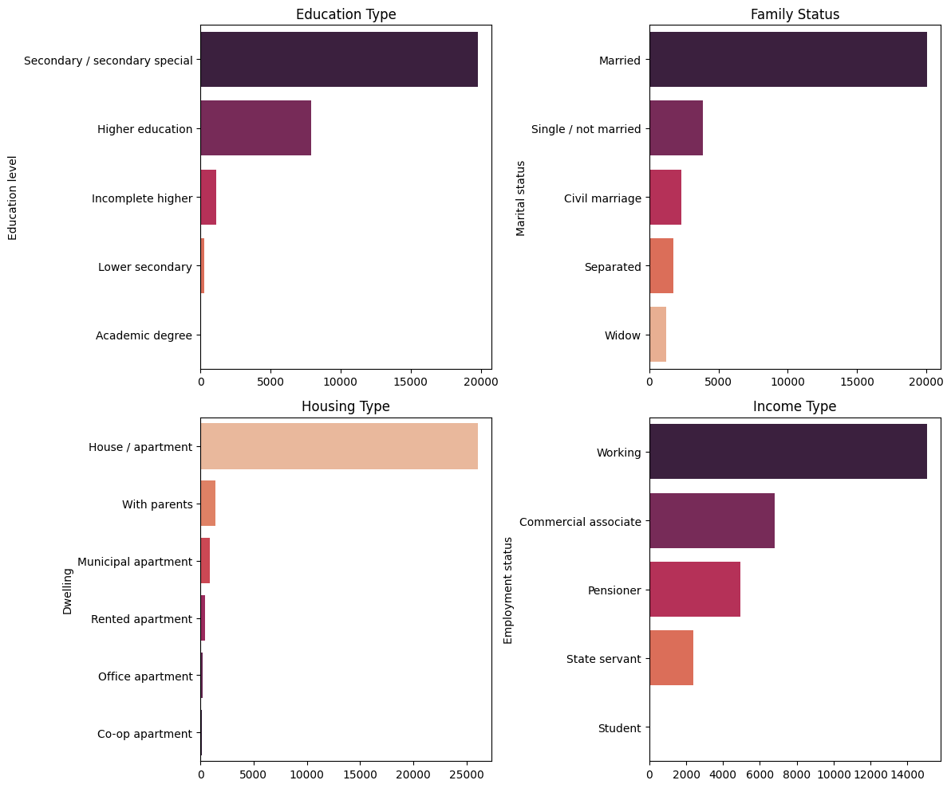

Slide 12
Machine Learning Models
Several machine learning models can be used for credit card fraud prediction, some common ones include:
Logistic Regression: A linear model that predicts the probability of an event (fraud) occurring.
Decision Tree: A tree-like structure that makes decisions based on a series of features (e.g., transaction amount, location).
Random Forest: An ensemble of decision trees that can improve the accuracy of predictions by combining the results of multiple trees.
Gradient Boosting: A sequential ensemble of models that can improve the accuracy of predictions by learning from the errors of previous models.

Slide 13

Model Training
Here are some features more commonly used for credit card fraud prediction:
Transaction Details: Amount, type (purchase, withdrawal, transfer), location, time, and currency.
Cardholder Information: Name on card, billing address, card verification value (CVV).
Account Details: Account history, recent transactions, spending patterns, credit limit.
Device Information: IP address, device type, operating system (for online transactions).

Slide 14
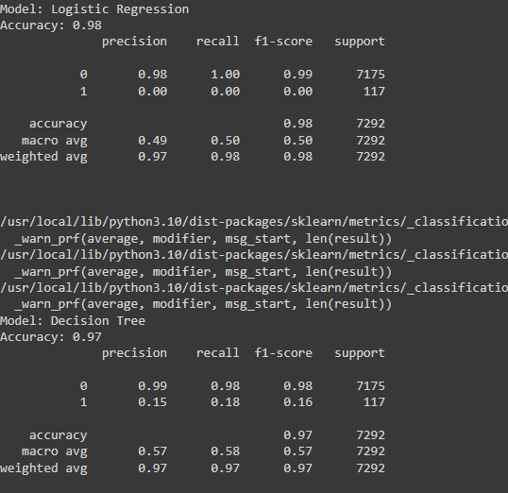
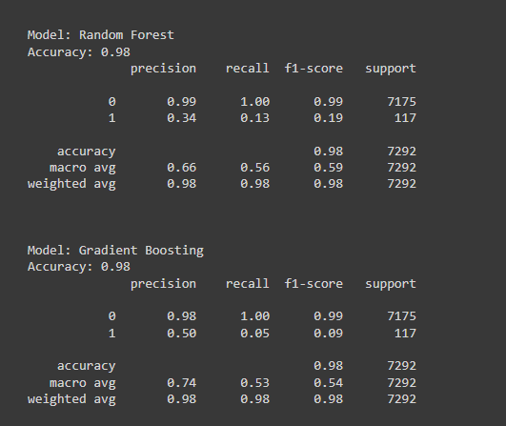
Evaluate the model

Slide 15
Conclusion
Credit card fraud is a significant threat, but machine learning offers a powerful tool for combating it.
By analyzing transaction data and cardholder information, machine learning models can identify patterns of fraudulent activity.
This allows financial institutions to improve fraud detection accuracy and protect their customers.
By leveraging machine learning, financial institutions can build a more robust defense against credit card fraud and ensure the security of their customers' financial transactions.

